Slide 1
463.10 Bitcoin
Presented by Carl A. Gunter
CS563/ECE524 Advanced Computer Security University of Illinois

Slide 2
Grade Guidelines
83-100 A
73-82 B
58-72 C
58 or less D

Slide 3
Citation
Bitcoin: A Peer-to-Peer Electronic Cash System
Satoshi Nakamoto
Manuscript

Slide 4
Overview
Currency systems rely on trust (government, bank). Is it possible to build a currency without trusted authorities?
Use a Proof of Work scheme to place authority in the hands of a distributed preponderance of capability.
The Bitcoin approach has been implemented in practice and now sees a multi-billion dollar capitalization.
This has inspired a fresh look at crypto currency and at the underlying techniques of Bitcoin.

Slide 5
Bitcoin’s three main protocols
Network: How can we share transactions & history?
Transactions: How can we agree what the history means?
Consensus: How can we agree on one global history?

Slide 6








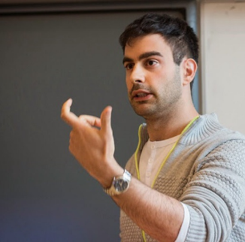
Introduction to
Cryptographic Currencies
Claudio Orlandi
cs.au.dk/~orlandi
Thanks to: Jon K. Sørensen and Peter S. Nordholt
Notes:
Different Friday lecture, this is NOT my research
Thanks to Jon, master thesis, thanks to Peter, for
Cryptographic currencies – digital money, there is no centralized authority printing money, there is no central banks controlling who owns which money, there are no credit card companies who control transactions. Everything is distributed, p2p. On the other screen you can see a website that shows all the activity as recorded by one of the peers of the network. Hopefully by the end of this talk you should be able to understand what’s going on there.

Slide 7




Outline
Part 0: a little history
Part 1: TheoryCoin
  How to create coins
  How to transfer coins
  How to store coins
Part 2: diff( , )
Part 3: Problems and issues
Notes:
A little history from the 90s
Theorycoin is a fake cryptocurrency that I invented for this talk, and hopefully I will be able to explain some basic principles underlying virtually all cryptocurrencies.
If there is no national bank, how do we print money?
How do we control transfers? IRL this is done by giving you a banknote, but you know well that when I give you a copy of a file I still have mine
And how do we remember who has what money, without the help of banks?
The difference
Problems, issues, research directions.

Slide 8
crypto currency
Notes:
When I talk to my family, crypto, james bond, secret communication.
Currency is money, why the relationship? Cryptography allows to do apparently impossible things in the digital world. Physics limits us IRL, cryptography (computaional hardness) limits us in the digital life.

Slide 9
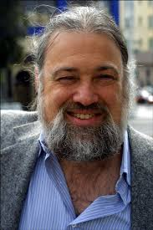
The 1990s
David Chaum and anonymous ecash
“The difference between
a bad electronic cash system
and well-developed digital cash
will determine whether
we will have a dictatorship
or a real democracy”
(attributed to Chaum)
Notes:
Chaum is a great cryptographer and mathematician.
In the 90s internet was spreading, it was clear that we needed an easy way to move money online.
So Chaum and others worked on the problem. Chaum was also idealist, and he cared about privacy for users, anonymous payments
Quote attributed, Ivan who knows David from CWI says it’s plausible.

Slide 10
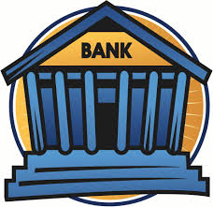






Anonymous payments
M or L?
”withdraw”
”withdraw”
Notes:
Formal definition.
Maybe mushrooms aren’t perfectly legal so the shop allows to do purchases through a hole in the wall, so no one sees each other.

Slide 11


Chaum’s anonymous e-cash
anonymous
secure (no double-spending)
only transfer (no creation/storage)
…and bankrupted in 1999
Notes:
Chaum only cared about how to move money, but he created this amazing ecash.

Slide 12
The advent of Bitcoin
2009: Bitcoin announced by Satoshi Nakamoto
  Pseudonym for person or group of people
2009-2011: slow start…
2011-2013: Silk Road and Dread Pirate Roberts
End 2013: Bitcoin price skyrockets
  and the world notices!
Notes:
Change tab – satoshi who is this guy?
Change tab – lily
Change tab – pizza
Change tab – mushroom joke
Change tab – price skyrocketed (apple)

Slide 13
Outline
Part 0: a little history
Part 1: TheoryCoin
  How to create coins
  How to transfer coins
  How to store coins
Part 2: diff( , )
Part 3: Problems and issues
Notes:
Ok, let’s talk theorycoin and understand how these things work

Slide 14
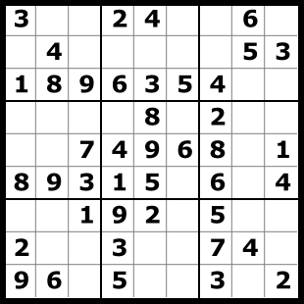

TheoryCoin:
How to create money
Everyone
tries to solve a puzzle
The first one to solve
the puzzle gets 1 TC
The solution of puzzle i
defines puzzle i+1

Slide 15
TheoryCoin:
How to create money
L ∈ {0,1}*
R ∈ {0,1}*
SolvePuzzle(L){
repeat{
R = my_name || i++
T = H(L,R)
}while(T ≠ 0^{d})
return R
}
H
(a random function)
T ∈ {0,1}^{d}
The puzzle:
given L, find R
such that T=0^{d}
* aka Proof-of-Work
Notes:
How long does it take to find a solutions? Approx 2d
If there function is truly random there are no shortcuts, you have to try a lot of different inputs!
Pseudocode.
You put your name in when you solve a puzzle, so everyone knows it was you who solved the puzzle.
Proof of work in bitcoin lingo

Slide 16
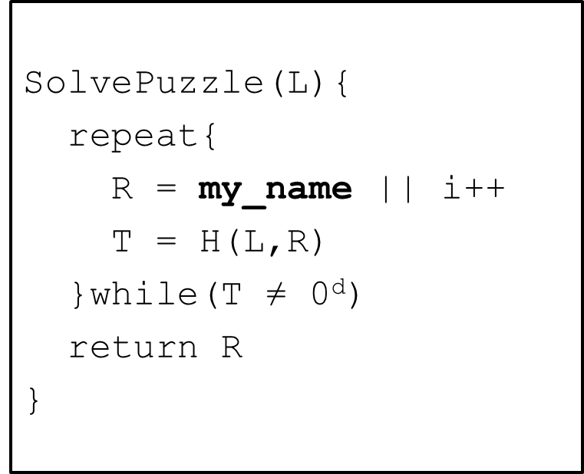
TheoryCoin: (coins to ppl)
How to create money
x₀ = Start!
x₁ =(P₁, i₁)
x₂=(P₂, i₂)
x₃=(P₃, i₃)
H
H
H
P₂
x₁
x₂
x3
000…000
000…000
000…000
x₂
P₁
x₁
x₃
P₃
* aka the blockchain
Notes:
Everyone tries to solve puzzle
P1 solves
Everyone can check. A new coin is created! And given to P1!
Everyone starts working on next puzzle
And we go on

Slide 17
TheoryCoin:
How to create money
x₃=(P₃, i₃)
x₆=(P₃, i₆)
x₇=(P₃, i₇)
x₀=Start!
x₁=(P₁, i₁)
x₂=(P₂, i₂)
x₄=(P₄, i₄)
x₅=(P₅, i₅)
* aka the 51% attack
Notes:
Something can go wrong right? What if two people find the solution for the same puzzle?
Well some people will now be working on the puzzle after x3, some after x4
At some point someone finds x5, and x3 is deleted (p3 does not get a coin!)
Of course the other branch of the chain could recover, and then it would be x4 x5 to be deleted. But honest people have an incentive in working on the longest chain, so that will eventually win and the protocol stabilizes itself.
In the same way, if the majority of parties are corrupted and collude, they can choose which chain they like most and ignore the rest.
This is called the 51 percent attack in bitcoinlingo

Slide 18
TheoryCoin:
How to create money
Recap:
Solve the next puzzle → get a coin
  To “solve” puzzle i find x_{i} s.t H(x_{i-1},x_{i})=0^{d}
  The longest chain defines “next puzzle”
  The name in block x_{i} “gets” coin i.

Slide 19
Outline
Part 0: a little history
Part 1: TheoryCoin
  How to create coins
  How to transfer coins
  How to store coins
Part 2: diff( , )
Part 3: Problems and issues

Slide 20
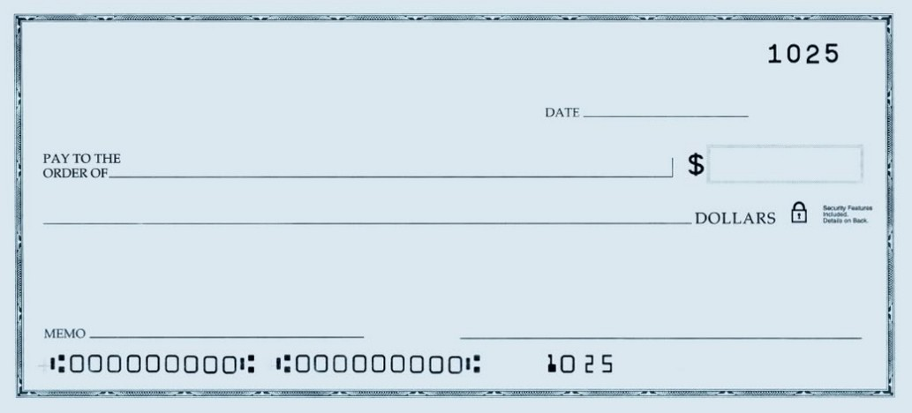
TheoryCoin:
How to transfer money
(Digital) Signatures
  Only you can sign
  Everyone can verify
  You cannot deny
Give coin 3 to Jesper
Claudio
Notes:
You should know digital signatures from security, cryptography, or by using your ebanking.
IRL you have the power of signing documents in a way that only you can sign, everyone can verify and you cannot deny
This has been used for centuries to move money, using checks.
Theorycoin works the same way.
You write I give my house to jesper. I give coin 3 to jesper. I sign the document and now the house is jespers.

Slide 21
TheoryCoin:
How to transfer money
Gen
“Your pin code”
“Your username”
secret key
public key
message
message, signature
accept/reject
Sign
Verify
Notes:
More formally, a signature scheme consitst of a key generation algorithm that gives you a secret key (if you are lost, think of a password, or a very long pincode, or a nemid piece of paper)
Then there is a public key, that you can just thins as your name. From now on I will use the terms public key and your name as sinonymoys
Now if you have a message you can sign it
And anyone with the public keys can check the signature and see if this is yours or not. And no one else can sign

Slide 22
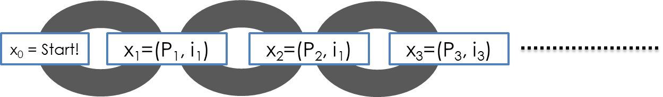
TheoryCoin:
How to transfer money
If
Ver(pk3,m,s) = accept
and
P3 owns coin 3
then
return accept
m=“P3 gives coin 3 to P1”
s=Sig(sk3,m)
P₃
P₁
Notes:
So it’s very simple to transfer money now.
I write a message and say I give you coin 3. And sign it
Now p1 checks that the signature is right
But how do you know p3 owns the coin, and therefore can give it to you? You go and check on the blockchain

Slide 23
TheoryCoin:
How to transfer money
m1=“P3 gives coin 3 to P1”
s1=Sig(sk3,m1)
P₁
accept
P₃
P₂
accept
m2=“P3 gives coin 3 to P2”
s2=Sig(sk3,m2)
* aka double spending
Notes:
Of course now there is a problem
How do you know I am giving the coin only to you?
Maybe p3 gives a check to p1 and then another one to p2
This is called double spending and we need to solve it.

Slide 24

TheoryCoin:
How to transfer money
write
(m1,s1)
read
(m1,s1)
P₁
write
(m4,s4)
accept
...
(m1,s1)
...
(m2,s2)
...
(m4,s4)
P₃
write
(m2,s2)
read
(m2,s2)
P₂
reject
read
(m4,s4)
P₄
m1 = “P3 gives coin 3 to P1”
s1 = Sig(sk3,m1)
m2 = “P3 gives coin 3 to P2”
s2 = Sig(sk3,m2)
m4 = “P1 gives coin 3 to P4”
s4 = Sig(sk1,m4)
Notes:
We could solve the problem by saying, instead of parties communicating between each other, they communicate via a bulletin board.
(This is what we do for houses, we register contracts in a trusted place)

Slide 25
Outline
Part 0: a little history
Part 1: TheoryCoin
  How to create coins
  How to transfer coins
  How to store coins
Part 2: diff( , )
Part 3: Problems and issues
Notes:
Of course we don’t want a central trusted bulletin board. So we do a really cool thing.

Slide 26
TheoryCoin:
How to store money
Main Idea:
Record transfers in the blockchain
Notes:
There is already a global memory, saying who has what, use it also to remember movements

Slide 27
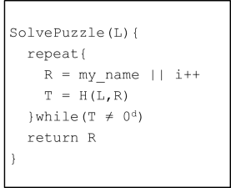
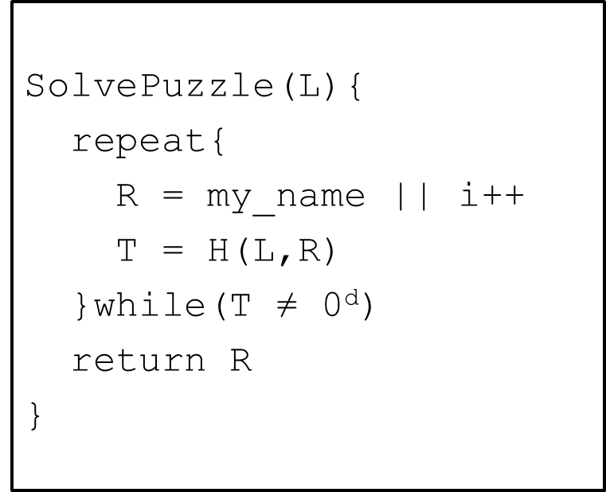
TheoryCoin:
How to store money
SolvePuzzle(L,...){
repeat{
R = my_name||(m,s)|| i++
T = H(L,R)
}while(T ≠ 0^{d})
return R
}
P₁
(m,s)
P₃
(m,s)
P₂
(m,s)
P₄
x₄=(P4, (m,s), i₄)
Notes:
When you make a transaction, you broadcast it to everyone. Now you can add it in the solution of the puzzle (like you did for your name)
Why would P4 do this? We come back later.

Slide 28
Outline
Part 0: a little history
Part 1: TheoryCoin
  How to create coins
  How to transfer coins
  How to store coins
Part 2: diff( , )
Part 3: Problems and issues
Notes:
Here are the major difference to bicoin

Slide 29
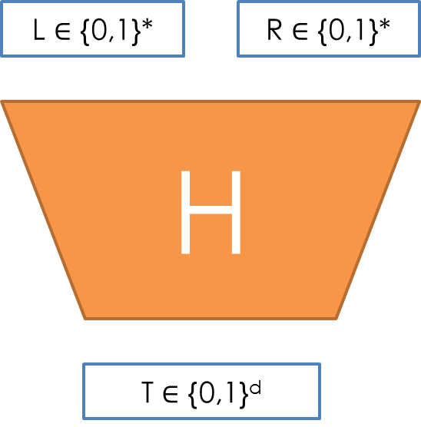
diff( , )
How is money created in Bitcoin?
New block every ~10 mins
  d adjusted every ~2000 blocks
H = 2-SHA2
Initial reward: 50 BTC
  Halved every ~4 years (12.5 BTC in March 2019)
Notes:
New block on average every 10 minuts, d adjusted to keep it like this
H is a cryptographic hash function, sha 2
The reward was 50 at the beginning and goes down every 4 years.

Slide 30
diff( , )
How is money transferred in Bitcoin?
Example: P1 wants to give 60 to P2
P1 gives 60 to P2
P2 gives 42 to P3
... gives 50 to P1
P2 gives 17 to P2
P1 gives 14 to P1
… gives 25 to P1
Transaction fee 1
Transaction fee 1
Notes:
Instead of simple checks, more complicated contract.
You say, I have 50 coins that Jesper gave me
I have 25 coins that Ivan gave me
Now I can give 60 coins to peter
I give 14 to myself
And I send 1 in transaction

Slide 31
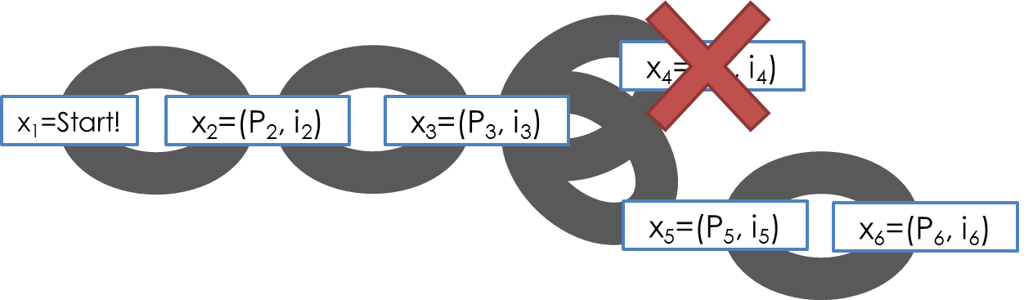
diff( , )
How is money stored in Bitcoin?
Transaction in orphaned blocks are invalid
  Wait 6 blocks (~1 hour) before accepting transaction.
  Checkpoints to prevent complete history rollback.
All transactions are stored in the blockchain
  (~100 GB in March 2019)
Notes:
Transaction in orphaned blocks are invalid, so wait.
CHANGE TAB

Slide 32
Outline
Part 0: a little history
Part 1: TheoryCoin
  How to create coins
  How to transfer coins
  How to store coins
Part 2: diff( , )
Part 3: Problems and issues

Slide 33
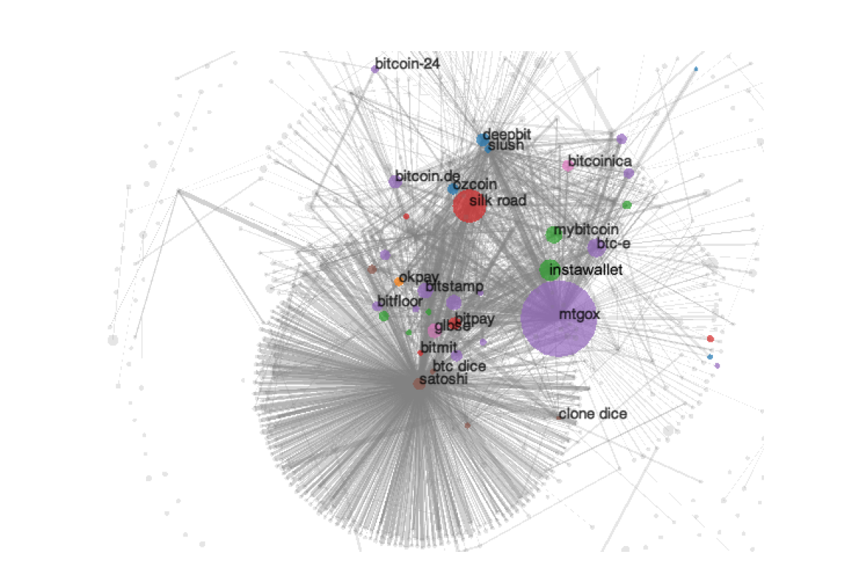
Anonymity?
Problem:
  Every transaction ever made is recorded forever
Solution?
  Use new identity for each transaction
But:
  Heuristics allow to cluster identities
Anonymous alternatives:
  Zerocoin, Zerocash…
Notes:
CHANGE TAB
Guy has 50K dollars
CHANGE TAB
wikileas

Slide 34
Programmable money?
Bitcoin uses a scripting system for transactions. Forth-like, Script is simple, stack-based, and processed from left to right. It is purposefully not Turing-complete, with no loops.
Script includes useful primitives.
E.g., “P1 gives 1 BTC to P2 if at least
2 out of (P1,P2,P3) sign this transaction”

Slide 35
Mining pools
Solving puzzles (mining) is hard!
  Miners join pools and share work/reward
How to optimally split work?
Mechanism design?
  rational miner?
  how to allocate reward?
Notes:
CHANGE TAB MINING POOLS

Slide 36
A final word…
Distributed currencies:
for the good guys or the bad guys?
  Crime is bad! Tax evasion is bad!
  But sometimes governments are bad too!
  Thanks! Questions?
Notes:
CHANGE TAB VISA

Slide 37
Sources:
Learn about signatures/ecash/cryptography at csaudk
https://services.brics.dk/java/courseadmin/crypto/
https://services.brics.dk/java/courseadmin/cpt
https://services.brics.dk/java/courseadmin/CryCom
Story of Chaum and DigiCash (to be taken with a grain of salt)
http://cryptome.org/jya/digicrash.htm
Bitcoin paper and announcement
http://article.gmane.org/gmane.comp.encryption.general/12588/
http://www.mail-archive.com/cryptography@metzdowd.com/msg10142.html
This pizza cost 750,000 usd
http://motherboard.vice.com/blog/this-pizza-is-worth-750000
Lily Allen turns down btcs
https://twitter.com/lilyallen/statuses/419942070770741249
Signature attack
http://eprint.iacr.org/2013/734
Deanonymizing
http://cseweb.ucsd.edu/~smeiklejohn/files/imc13.pdf
http://eprint.iacr.org/2012/584
Zerocoin/Zerocash
http://zerocoin.org/
Graphs, stats etc
www.blockchain.info
Comparison with Altcoins
http://www.coinwarz.com/cryptocurrency
Bitcoin stolen from TV
http://nymag.com/daily/intelligencer/2013/12/bloomberg-anchors-christmas-bitcoin-gets-stolen.html
Visa/Mastercard vs Wikileaks
http://www.forbes.com/sites/andygreenberg/2010/12/07/visa-mastercard-move-to-choke-wikileaks/
Not in the talk, but very interesting:
Silkroad essentials
http://exitevent.com/privacy-tor-btc-and-what-the-silk-road-crackdown-means-to-you-131112.asp http://arstechnica.com/tech-policy/2013/10/how-the-feds-took-down-the-dread-pirate-roberts/ http://pando.com/2014/01/02/with-130m-of-bitcoin-wealth-and-plans-to-sell-the-fbi-could-rattle-the-virtual-currency-cage
The value overflow bug
https://en.bitcoin.it/wiki/Common_Vulnerabilities_and_Exposures#CVE-2010-5139
The March 2013 chain fork
https://bitcoin.org/en/alert/2013-03-11-chain-fork
Buggy transaction, mistery miner
https://blockchain.info/tx-index/3618498/4005d6bea3a93fb72f006d23e2685b85069d270cb57d15f0c057ef2d5e3f78
https://bitcointalk.org/index.php?topic=67634.0
The problem with “checkpointed” bitcoin
http://www.links.org/files/decentralised-currencies.pdf
This presentation contains copyrighted images the use of which has not always been specifically authorized by the copyright owner. I am making the material available for educational purposes only and I believe this constitutes a 'fair use'.

Slide 38
Changing Bitcoin
Similar to experience with IPv4 -> IPv6
  No “flag day” possible
Hard fork: the blockchain splits
  Example: updated nodes recognize a new type of transaction but old nodes do not
Soft fork: nodes have trouble registering certain transactions until they update
  Example: updated nodes stop recognizing a given type of transaction but old nodes still do
  Self-correcting if majority computing power updates

Slide 39
MP4 Overview
Code skeleton is provided
Checkpoint 1:
  Get familiar with Bitcoin API
  Get familiar with blockchain structures
Checkpoint 2:
  Cluster bitcoin addresses
  Generate and analyze user graph
Report: one-page
Due date: by midnight on Thursday April 3rd

Slide 40
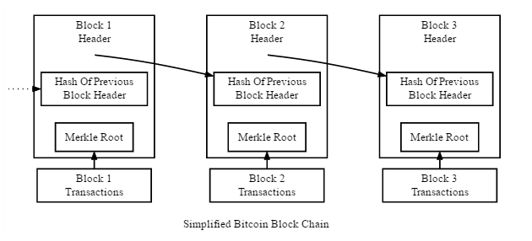
MP4 Checkpoint 1
Blockchain structures: Blocks

Slide 41


MP4 Checkpoint 1
Blockchain structures: Transactions
……
TX 2
TX 0
Input 01
TX 1
Input 01
Output 01
Input 01
Input 02
Output 01
Output 01
Output 02
TX 3
Input 01
Output 01
Output 02
Notes:
Transactions: inputs and outputs
Two types of transactions
Coinbase tx: generation of bitcoin, no previous outputs
Normal tx: transferring of bitcoins, associated with previous outputs

Slide 42
MP4 Checkpoint 2
Cluster Addresses
Joint control assumption:
  Addresses used as inputs to a common transaction are controlled by the same entity
Download all the transactions on 10/25/2013, and cluster the addresses

Slide 43
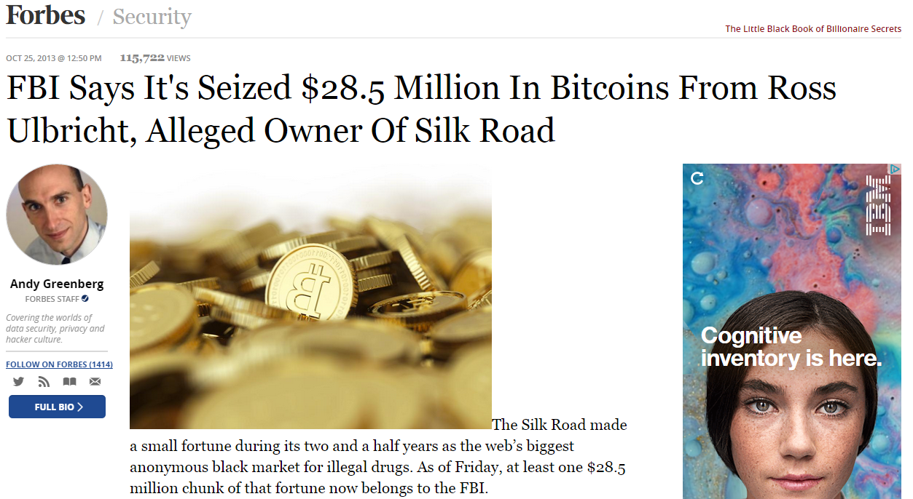
Why 10/25/2013 ?

Slide 44
Discussion
Is Bitcoin a waste of electricity?
Will Bitcoin enable criminal activity? Will it support democracy?
What new capabilities might be enabled by Bitcoin?
What are the prospects for alternative forms of crypto-currency (“altcoins”)?

